Slide 1
Control Problems in Robotics A FULLY ACTUATED QUADROTOR WITH A PROPELLER TILTING MECHANISM
Antonio Bozza – 1836119
Saverio Taliani – 1841465
Valentina Becchetti – 1739063
Control Problems in Robotics
Sapienza University of Rome

Slide 2
Table of contents
Introduction
Tilting mechanism modeling
Tilting mechanism control
Simulations
Extension
Conclusions

Slide 3
Quadrotors
Particular set of UAV famous for their versatility
Usually composed by a sigle rigid body equipped with four propellers
The underactuation is their main drawback causing them the inability to track 6D trajectories
A FULLY ACTUATED QUADROTOR WITH A PROPELLER TILTING MECHANISM

Slide 4
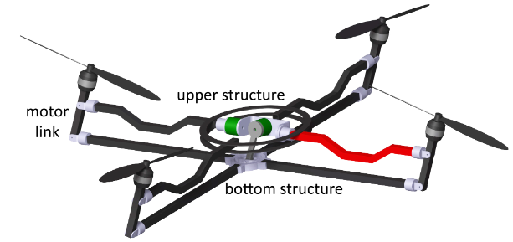
Tilting mechanism
In the following analysis we threat modelling and control of a quadrotor which result to be fully actuated thanks to the addition of two actuators able to change the orientation of the propellers.
Underactuated quadrotor cannot be deployed to track or regulate a desired orientation
Tilting propellers allows to perform whatever trajectory we want
A FULLY ACTUATED QUADROTOR WITH A PROPELLER TILTING MECHANISM

Slide 5
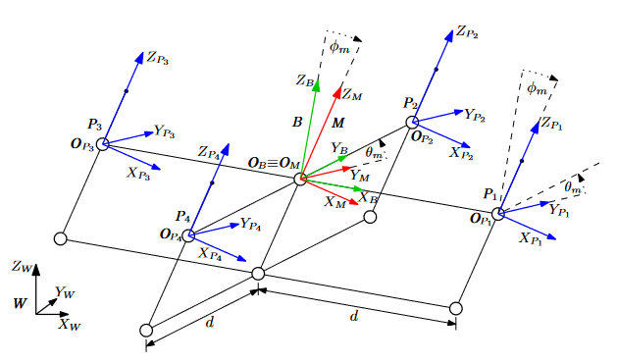
Structure description
Parallelogram structure :
Modifies roll and pitch angles of the propellers w.r.t. to body frame
Joint limits: {-π/6, π/6}
All propelles have the same orientation
A FULLY ACTUATED QUADROTOR WITH A PROPELLER TILTING MECHANISM

Slide 6
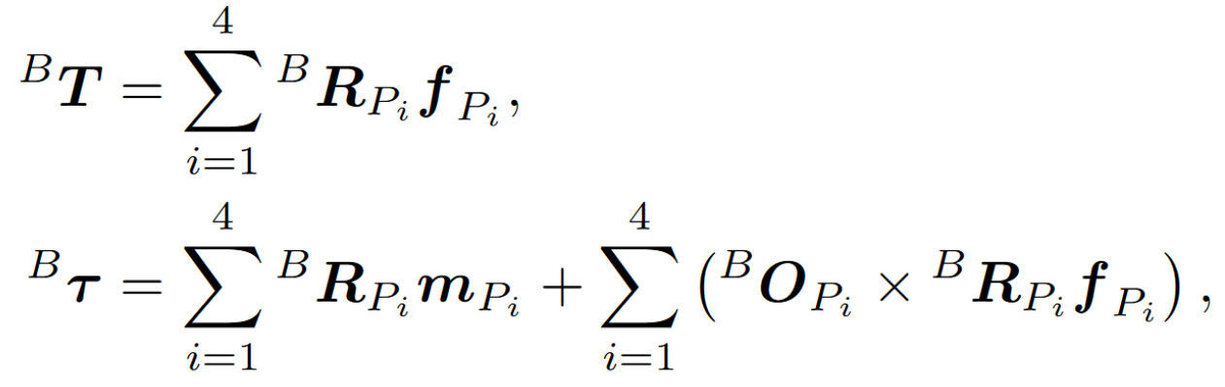
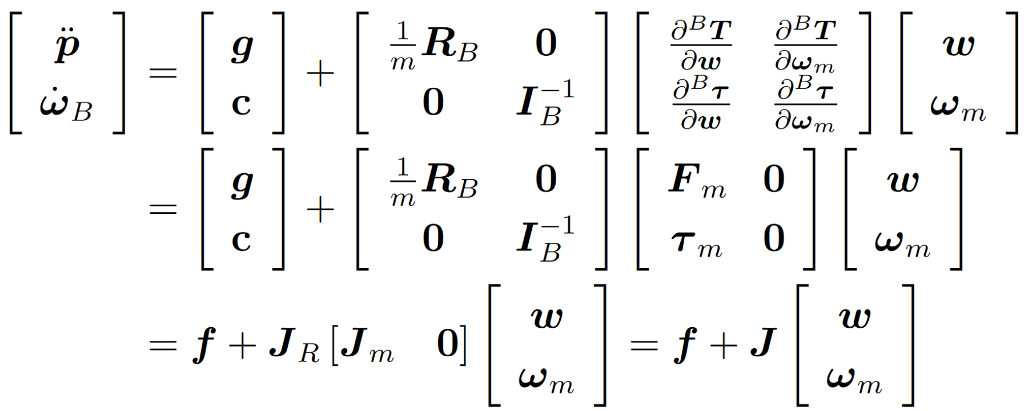
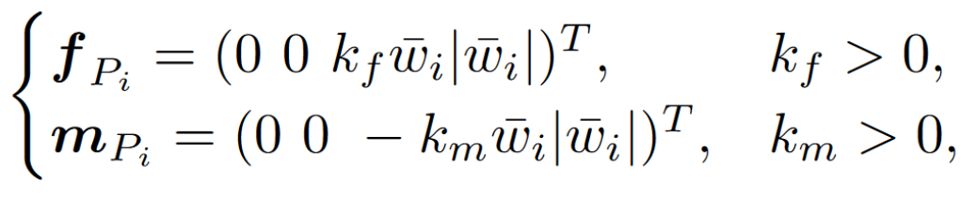
Model
Produced thrust and moment in propeller frame
Total thrust and torque in body frame
Dynamic model
A FULLY ACTUATED QUADROTOR WITH A PROPELLER TILTING MECHANISM

Slide 7
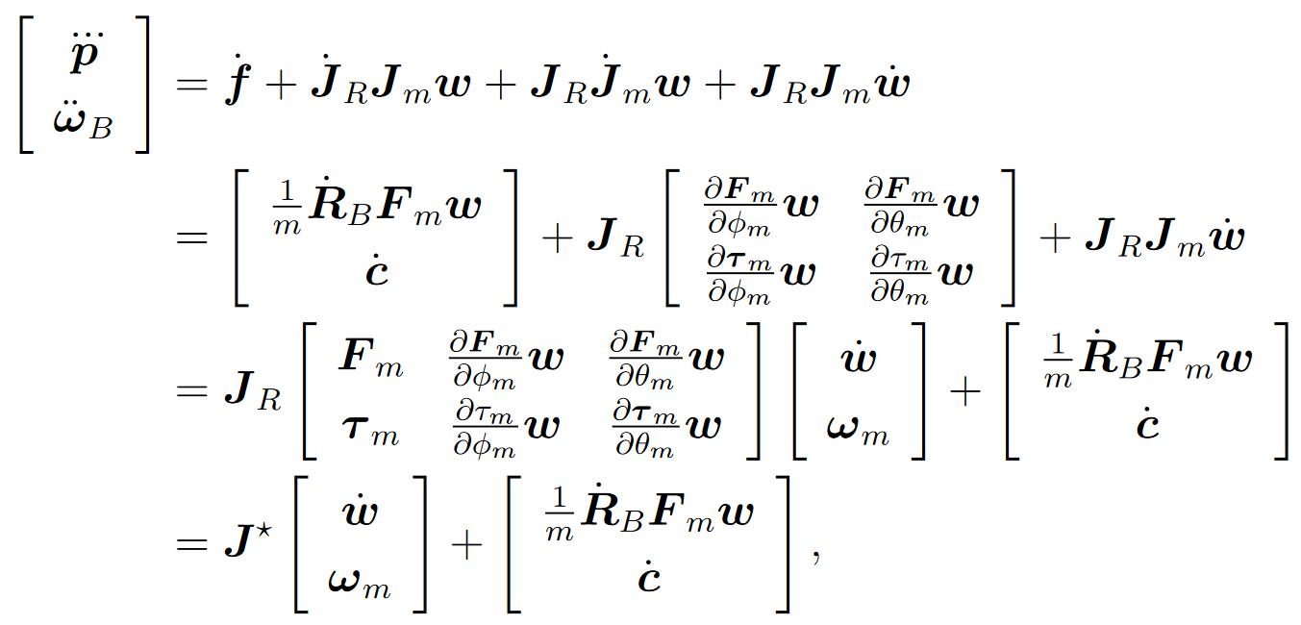
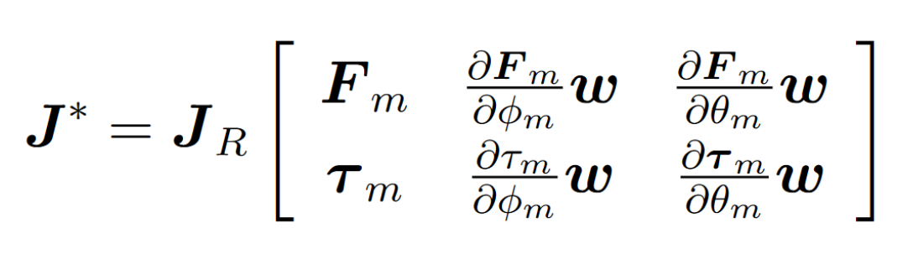
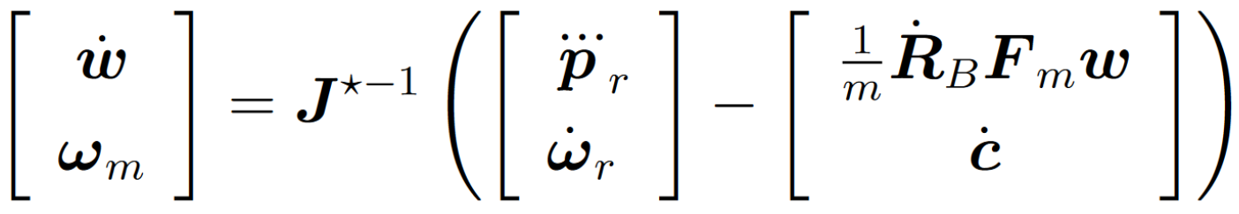
Control
Dynamic extension
Control input: Feedback linearization, reference input $[{\overset{⃛}{p_{r}}}^{T},{\ddot{ω_{r}}}^{T}]$
Where J* is given by:
A FULLY ACTUATED QUADROTOR WITH A PROPELLER TILTING MECHANISM

Slide 8
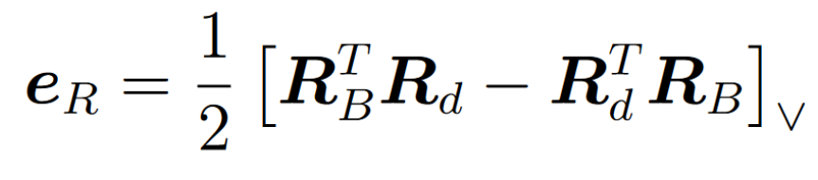
Control
Position feedforward and feedback
Orientation feedforward and feedback
Where the orientation error is computed as:
A FULLY ACTUATED QUADROTOR WITH A PROPELLER TILTING MECHANISM

Slide 9
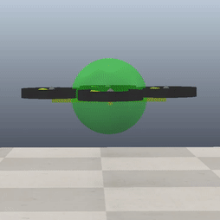
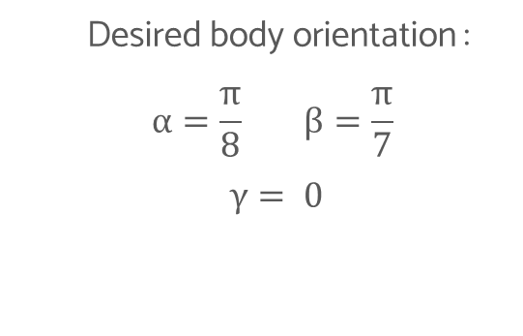
Hovering with desired orientation
Desired body orientation :
$$α=\frac{π}{8} β=\frac{π}{7}$$
$γ= 0$
A FULLY ACTUATED QUADROTOR WITH A PROPELLER TILTING MECHANISM

Slide 10
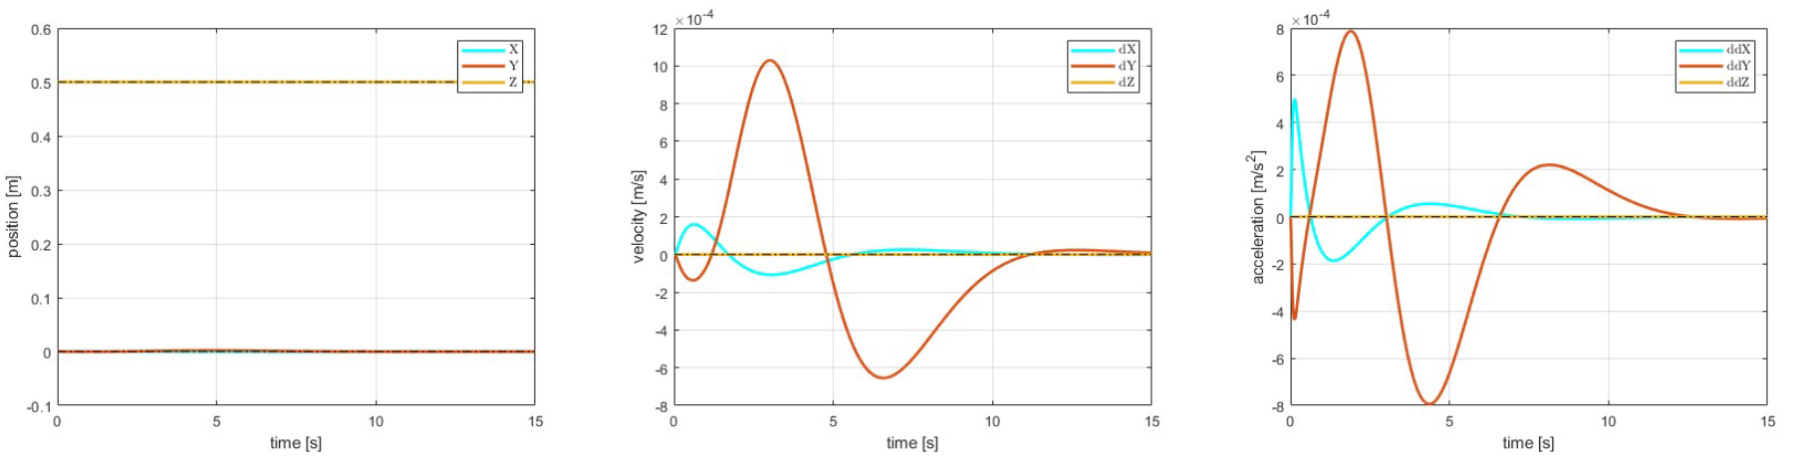
Hovering with desired orientation
Position
Velocity
Acceleration
A FULLY ACTUATED QUADROTOR WITH A PROPELLER TILTING MECHANISM

Slide 11
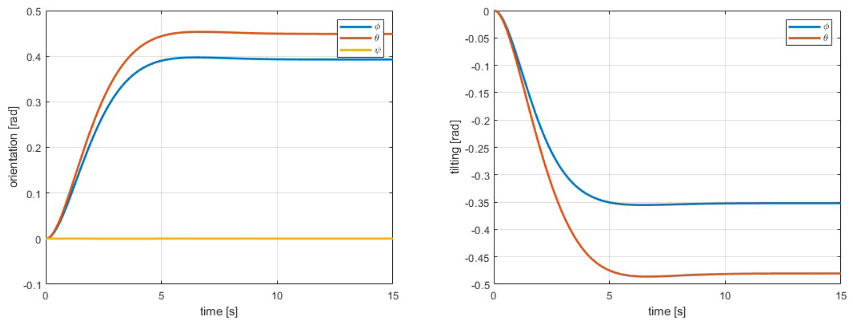
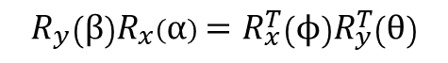
Hovering with desired orientation
$$R_{y}\left(β\right)R_{x}\left(α\right)=R_{x}^{T}\left(ϕ\right)R_{y}^{T}\left(θ\right)$$
Orientation
Tilting angles
A FULLY ACTUATED QUADROTOR WITH A PROPELLER TILTING MECHANISM

Slide 12
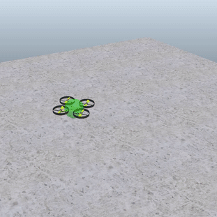
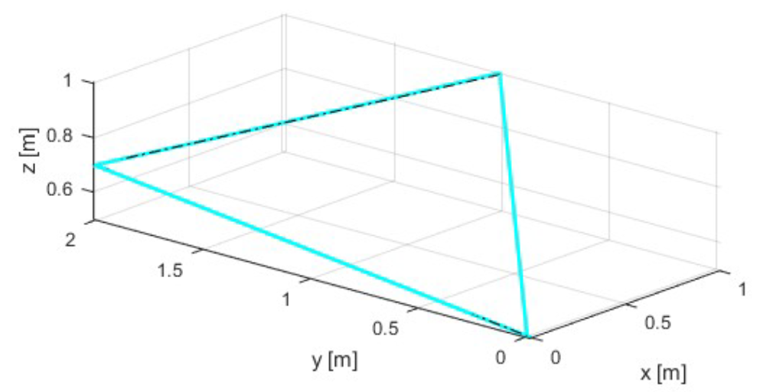
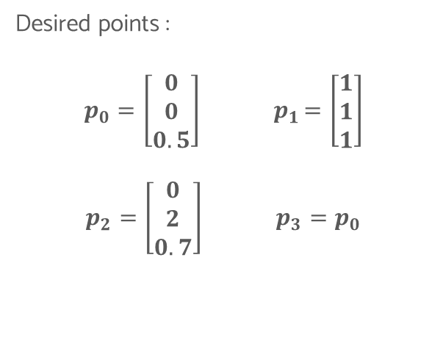
Linear path
Desired points :
$$p_{0}=\left[\begin{matrix}0 \\ 0 \\ 0.5\end{matrix}\right]{ p}_{1}=\left[\begin{matrix}1 \\ 1 \\ 1\end{matrix}\right]$$
$$p_{2}=\left[\begin{matrix}0 \\ 2 \\ 0.7\end{matrix}\right] p_{3}=p_{0}$$
A FULLY ACTUATED QUADROTOR WITH A PROPELLER TILTING MECHANISM

Slide 13
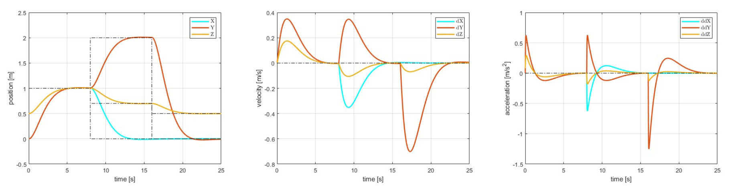
Linear path
Position
Velocity
Acceleration
A FULLY ACTUATED QUADROTOR WITH A PROPELLER TILTING MECHANISM

Slide 14
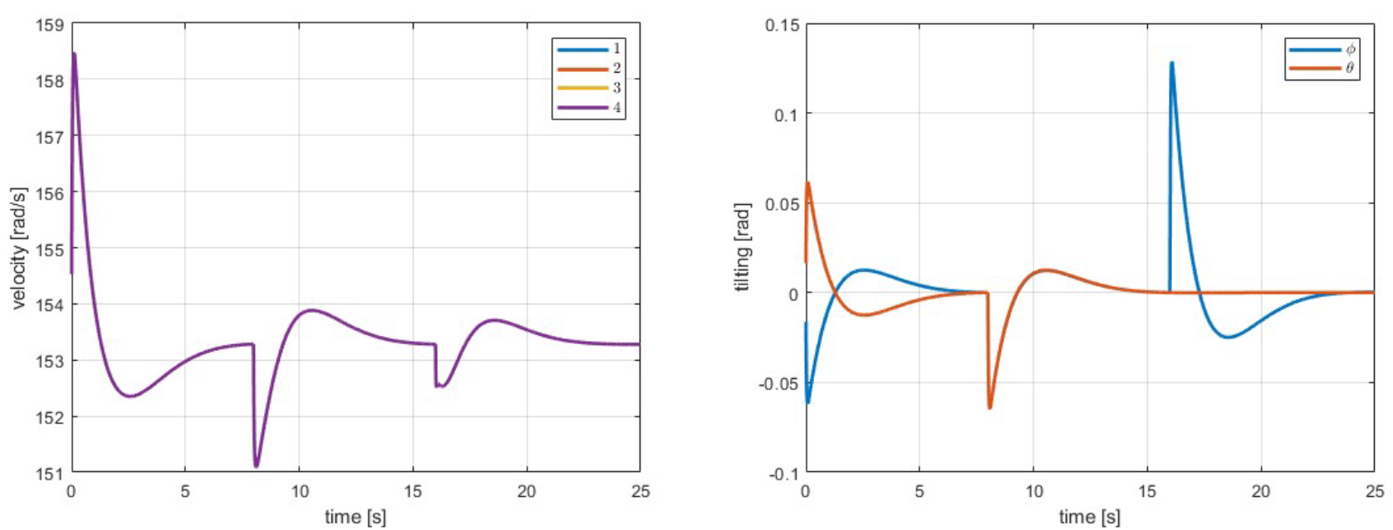
Linear path
Propellers velocities
Tilting angles
A FULLY ACTUATED QUADROTOR WITH A PROPELLER TILTING MECHANISM

Slide 15
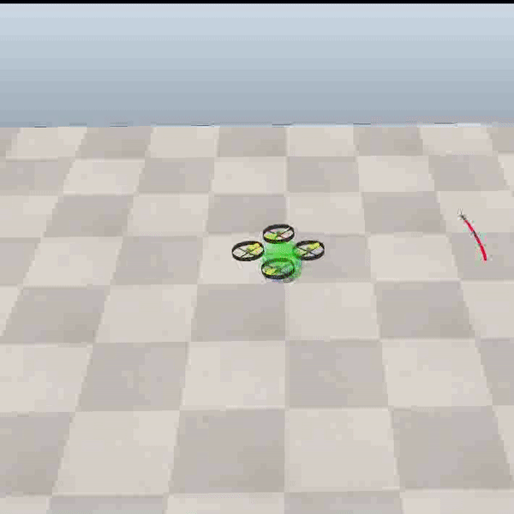
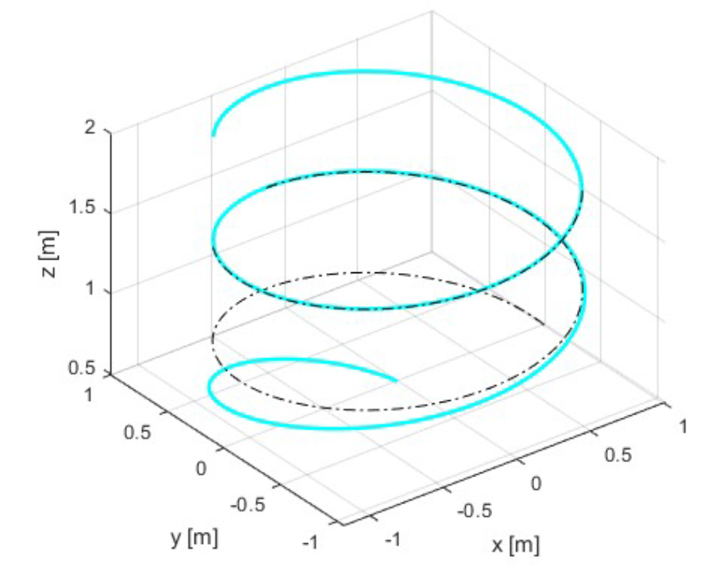
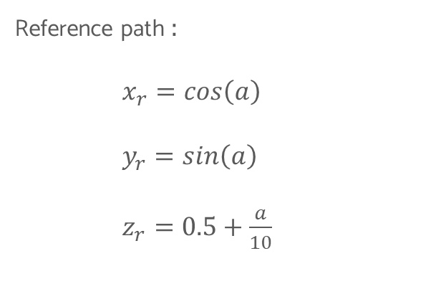
Spiral with initial error
Reference path :
$x_{r}=cos\left(a\right)$
$y_{r}=sin\left(a\right)$
$z_{r}=0.5+\frac{a}{10}$
A FULLY ACTUATED QUADROTOR WITH A PROPELLER TILTING MECHANISM

Slide 16
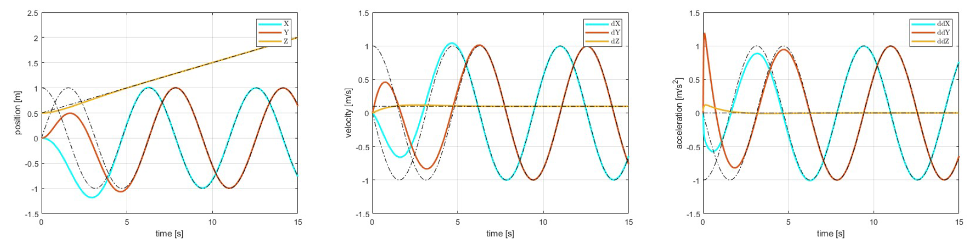
Spiral with initial error
Position
Velocity
Acceleration
A FULLY ACTUATED QUADROTOR WITH A PROPELLER TILTING MECHANISM

Slide 17
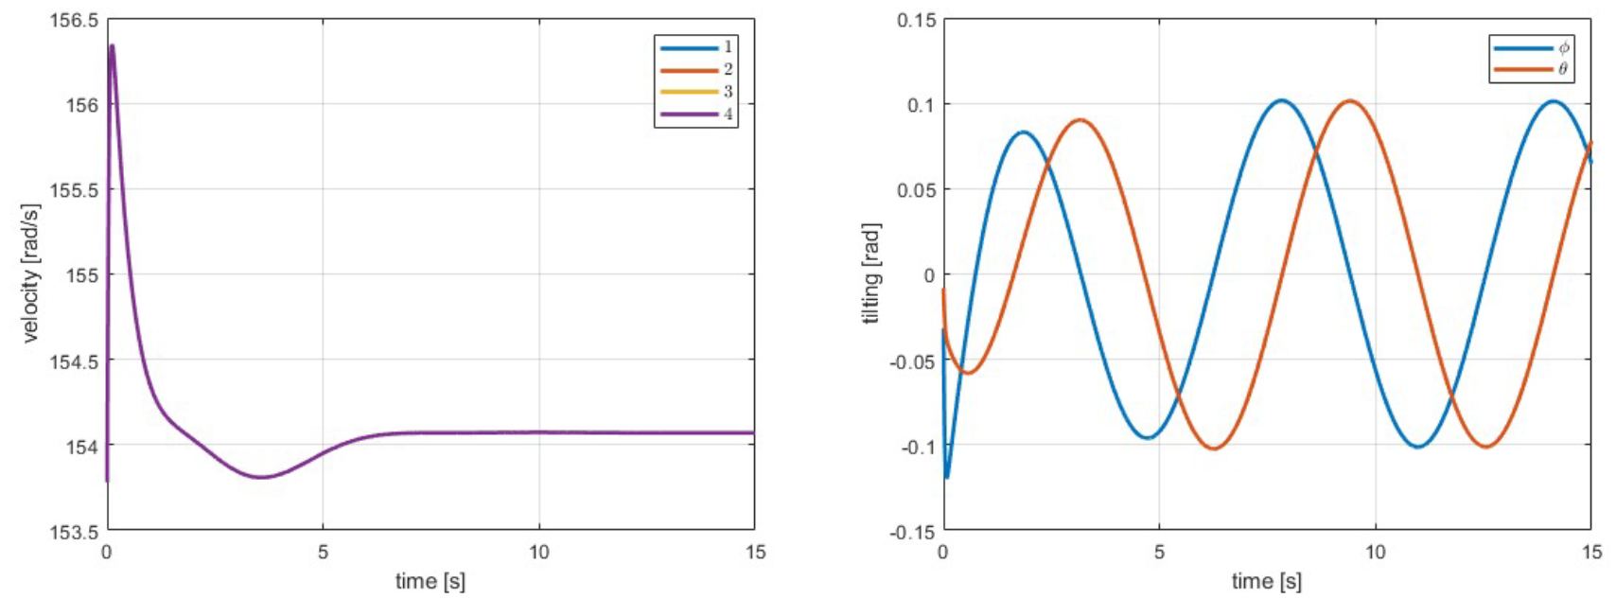
Spiral with initial error
Propeller velocities
Tilting angles
A FULLY ACTUATED QUADROTOR WITH A PROPELLER TILTING MECHANISM

Slide 18
Tilting mechanism: Pros & Cons
Pros
Cons
We effectively overcome underactuation drawbacks
We are able to correcly track 6D trajectories
We are able to perform hovering with a tilted body
Limited tilting angles
We are not able to perform hovering with body orientation grater or equal to π/6
The controller is not able to use body orientation in order to satisfy high lateral accelerations
A FULLY ACTUATED QUADROTOR WITH A PROPELLER TILTING MECHANISM

Slide 19
Solutions
Limited tilting angles
We are not able to perform hovering with body orientation grater or equal to π/6
The controller is not able to use body orientation in order to satisfy high lateral accelerations
Hardware modifications
Modify the control strategy
A FULLY ACTUATED QUADROTOR WITH A PROPELLER TILTING MECHANISM

Slide 20

Hybrid control strategy
Condition
Required orientation < $π$/6
TRUE
FALSE
We use the tilting mechanism in order to properly track 6D trajectories
fix the propeller orientation wrt the body to the limit
use a dynamic feedback linearization for a classic quadrotor to achieve the body orientation that is needed
A FULLY ACTUATED QUADROTOR WITH A PROPELLER TILTING MECHANISM

Slide 21
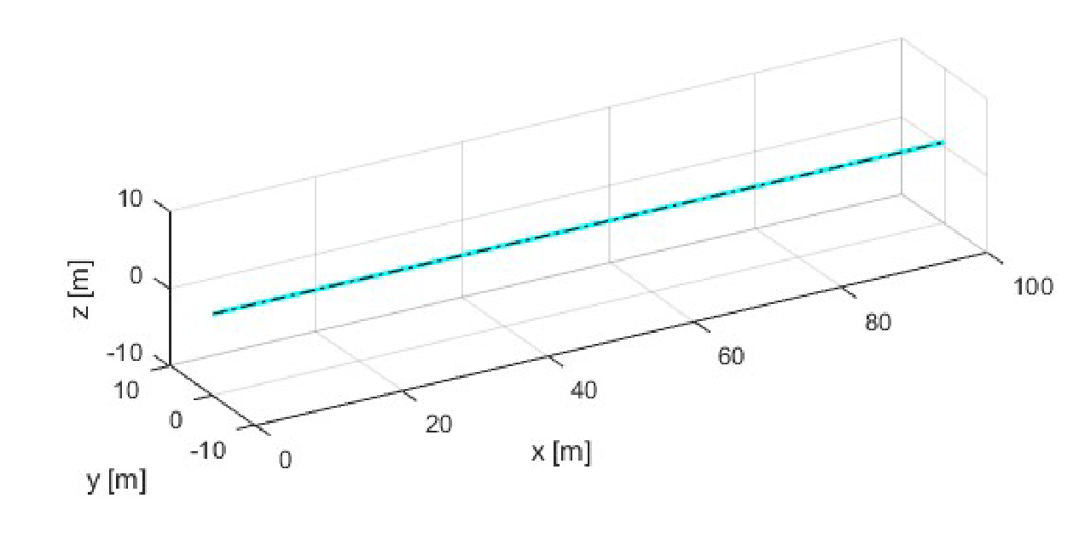
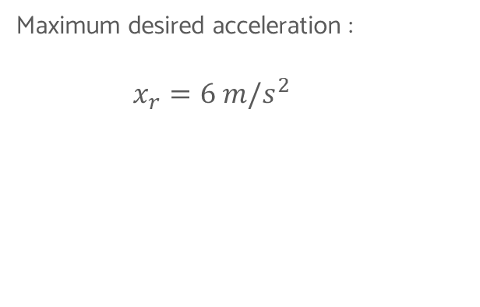
Fast lateral move
Maximum desired acceleration :
$x_{r}=6 m/s^{2}$
A FULLY ACTUATED QUADROTOR WITH A PROPELLER TILTING MECHANISM

Slide 22
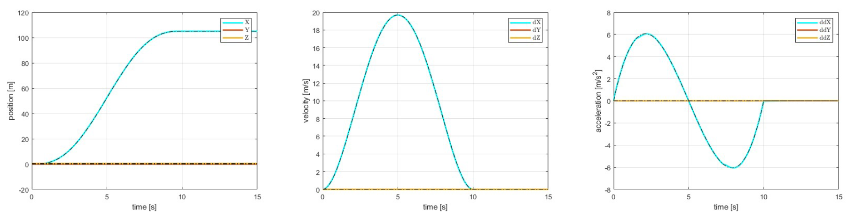
Fast lateral move
Position
Velocity
Acceleration
A FULLY ACTUATED QUADROTOR WITH A PROPELLER TILTING MECHANISM

Slide 23
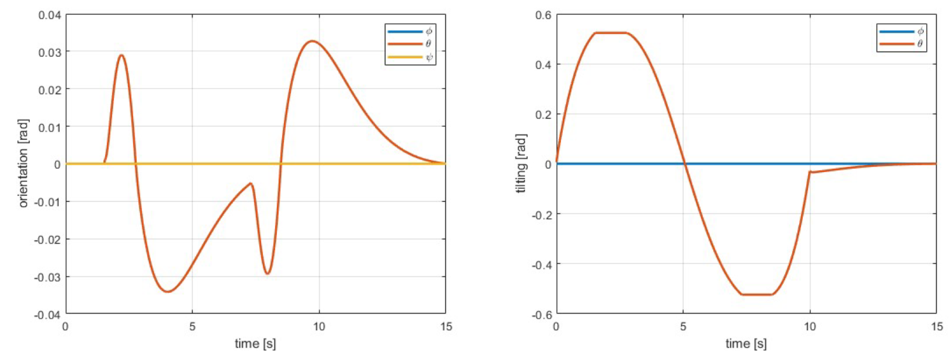
Fast lateral move
Body orientation
Tilting angles
A FULLY ACTUATED QUADROTOR WITH A PROPELLER TILTING MECHANISM

Slide 24
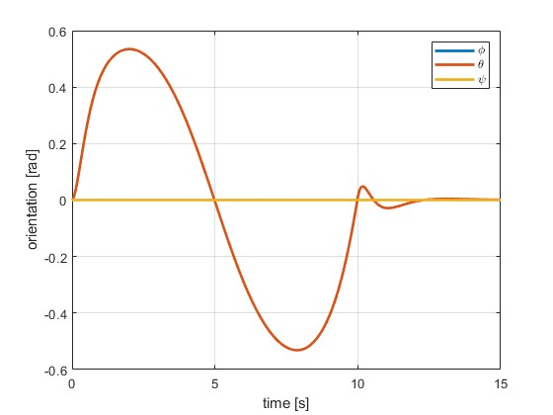
Fast lateral move
Body orientation – Hybrid Control
Body orientation – Classic Control
A FULLY ACTUATED QUADROTOR WITH A PROPELLER TILTING MECHANISM

Slide 25
Conclusions
The tilting mechanism is a reasonable improvement to overcome under-actuation limits in classic quadrotors
The proposed controller effectively stabilizes 6D trajectories but making use only of the tilting mechanism it bring some limitation in performances
The Introduction of the Hybrid controller gives the possibility to overcome performance limitations of the tilting mechanism by only sacrificing for the minimum time possible the orientation task
A FULLY ACTUATED QUADROTOR WITH A PROPELLER TILTING MECHANISM

Slide 26
References
Papers:
M. Odelga, P. Stegagno, and H. H. Bülthoff, “A fully actuated quadrotor uav with a propeller tilting mechanism: Modeling and control,” in 2016 IEEE International Conference on Advanced Intelligent Mechatronics (AIM), 2016, pp. 306–311.
R. Mahony, V. Kumar, and P. Corke, “Multirotor aerial vehicles: Modeling, esti- mation, and control of quadrotor,” IEEE Robotics Automation Magazine, vol. 19, no. 3, pp. 20–32, 2012.
S. A. Al-Hiddabi, “Quadrotor control using feedback linearization with dynamic extension,” in 2009 6th International Symposium on Mechatronics and its Applica- tions, 2009, pp. 1–3.
A FULLY ACTUATED QUADROTOR WITH A PROPELLER TILTING MECHANISM

Slide 27
Thank you for the attention!

